Slide 1

SEND Information Report
2025-26
DEBDEN PRIMARY ACADEMY
NURTURE, PROGRESS, EXCEL

Slide 2
AIMS
DEBDEN PRIMARY ACADEMY
NURTURE, PROGRESS, EXCEL
Debden Primary Academy is a fully inclusive school who ensures that all pupils achieve their potential personally, socially, emotionally, physically and educationally.
Our SEND information report lets you understand how we support pupils with special educational needs and disabilities.
Children are identified as having SEND when they have a significantly greater difficulty in learning than the majority of children the same age or have a disability which prevents or hinders them from making use of education facilities of a kind generally provided for children of the same age in schools within the area of the Local Authority (SEND Regulations 2014).
The Special Education Needs Co-ordinator (SENDCo) is Claudia Cope.
The Governor with responsibility for SEND is Isobel Tunnecliff.

Slide 3
HOW DO WE IDENTIFY CHILDREN’S NEEDS?
DEBDEN PRIMARY ACADEMY
NURTURE, PROGRESS, EXCEL
STEP 1: CONCERNS ARISE
Compare to age related expectations and identified as Wave 1, 2 or 3
STEP 2: ASSESS AND IDENTIFY NEED
STEP 3 HIGH QUALITY TEACHING
Monitoring List
STEP 3: INTERVENTIONS
STEP 4: ONE PLAN
EHCP application

Slide 4
STEP 1: CONCERNS ARISE
DEBDEN PRIMARY ACADEMY
NURTURE, PROGRESS, EXCEL
Concerns raised by teacher/ parent/student through observations in class/at home or through ongoing assessments completed.
Liaison with external agencies and professionals
Health diagnosis
At Debden we use a variety of assessments to identify where the gaps/any difficulties in learning are:
-Speech and Language (The Communication Trust Progression tools)
-Reading fluency
-Numeracy (Times Tables Rockstars and Numbots)
-Spelling of High Frequency Words
-PIRA/PUMA Assessment
-SDQ
STEP 2: ASSESS AND IDENTIFY NEED
Children are categorised as Wave 1, 2 or 3 dependent on their level of need

Slide 5
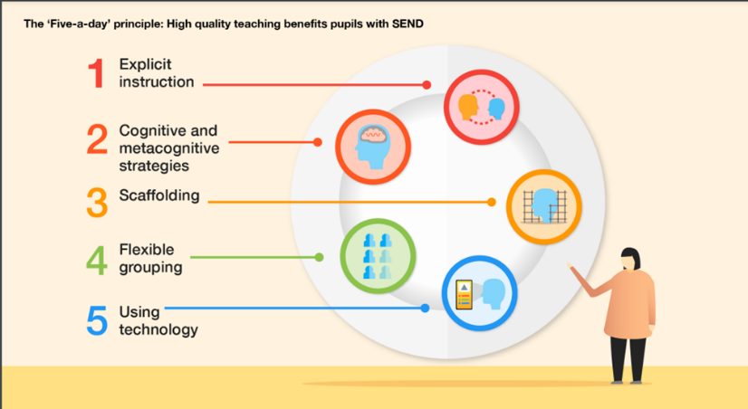
STEP 3: HIGH QUALITY TEACHING AND TARGETED INTERVENTION
DEBDEN PRIMARY ACADEMY
NURTURE, PROGRESS, EXCEL
HIGH QUALITY TEACHING | TARGETED INTERVENTIONS
All teachers will use the EEF 5 a day principles to support children with SEND | - Precision Teaching Spelling - Elklan Speech and Language - Phonics - Paired reading (fluency) - Learning Mentoring - Numeracy (Numbots and Times Tables Rockstars) - Sensory Circuits Children’s most significant gaps are addressed first. Short, sharp, highly focused 2-week interventions to meet specific targets. Children are placed on the monitoring list

Slide 6

STEP 4: ONE PLAN
DEBDEN PRIMARY ACADEMY
NURTURE, PROGRESS, EXCEL
If after 2 terms the child has not made adequate progress then they will be placed on the SEN register and a personalised ‘One Plan’ will be put together.
The Graduated response is used to support the ‘One-Plan’ and all the provision and intervention that are used for a child follows an Assess, Plan, Do and Review cycle.
The graduated response recognises that all children/young people learn in different ways and can have different types and levels of Special Educational Needs. The 2014 SEND Code of Practice outlines four areas of Special Educational Needs:
Communication and interaction
Cognition and learning
Social, emotional and mental health
Sensory/physical needs

Slide 7
ONE PLANNING PROCESS
DEBDEN PRIMARY ACADEMY
NURTURE, PROGRESS, EXCEL
A One Plan includes:
Individual aims and targets for each child with targeted provision and interventions outlined.
The young person’s views and what they want to achieve on their learning journey.
The views of the parents and what they would like to see as an outcome from their child’s time at school.
Staff views
This is reviewed termly and updated as necessary, alongside parents.

Slide 8
ehcp
DEBDEN PRIMARY ACADEMY
NURTURE, PROGRESS, EXCEL
If a child is not making expected progress with their One Plan targets, we would follow the assess plan, do, review and seek external professional support.
If after 3 cycles of this approach progress is still not being made we would consider further support which could include a EHCP needs application form.

Slide 9
WAVE SYSTEM
DEBDEN PRIMARY ACADEMY
NURTURE, PROGRESS, EXCEL
Based on their assessment results children are placed into Wave 1, 2 or 3. This enables us to target the correct level of support to match the child’s needs.
Wave | Typical Profile | Support
Wave 1 | -All children will benefit from this. -Those who find one/some learning areas difficult. -May be WTS in one or two areas. | High quality teaching
Wave 2 | -Children who are falling behind age-expected level. -May be WTS in a number of areas or BLW in one area. | -Interventions that are often targeted at a group of pupils with similar needs. May be groups in class etc.
Wave 3 | -Those with significant gaps across the curriculum. -Basic skills chronically hinder learning -May be BLW in a number of curriculum areas. | -High level of additional support/specialised provision. - Intervention designed to accelerate progress by prioritising key learning areas for maximum impact.

Slide 10
WORKING WITH OUTSIDE AGENCIES
DEBDEN PRIMARY ACADEMY
NURTURE, PROGRESS, EXCEL
As a school we work closely with any external agencies that we feel are relevant to individual children’s needs within our school including:
Educational Psychologist
Inclusion Partner
Emotional wellbeing and mental health services (EWHMS)
School nurse
ADHD nurse
OT and physiotherapist
Family support workers
In addition to this, we have a designated leads to promote the safeguarding and welfare of our students.

Slide 11
Working with Parents
DEBDEN PRIMARY ACADEMY
NURTURE, PROGRESS, EXCEL
We value the partnership with parents/carers and encourage a collaborative approach to supporting the children.
This will occur in many ways:
-Parents evenings
-One planning meetings/reviews
-Annual EHCP reviews
-Transition meetings
-1:1 meetings
-Liaising with external professionals
We welcome contact from parents at any time. This can be via telephone, email or through a scheduled meeting.

Slide 12
ACCESSIBILITY
DEBDEN PRIMARY ACADEMY
NURTURE, PROGRESS, EXCEL
All parts of the school are fully accessible.
We aim for all children to be able to access the school curriculum and to be included on school trips.
A risk assessment is carried out prior to any off site activity to ensure every child’s health & safety.
The school site is wheelchair accessible with disabled toilets.
Additional support could include:
Modified furniture
Mobility training
Access to specialist teacher input
Coloured overlays
Access to laptop & tablet technology

Slide 13
Complaints
The majority of concerns are handled under the following general procedures.
Stage 1 aims to resolve the concern through informal contact at the appropriate level in school. Send the concern to admin@debden.school.essex.co.uk or speak to the class teacher.
Stage 2 is the first formal stage at which written complaints are considered by the Headteacher or the designated Governor, who has special responsibility for dealing with complaints.
Stage 3 is the next stage once Stage 2 has been worked through. It involves a complaints review panel of Governors.
Stage 4 is the LEA Review stage where the local education authority will review and comment upon the way we have dealt with a complaint.
How each of these stages operates is explained in more detail in the school’s Complaints Policy.

Slide 14
Further Information
The Essex Local offer, includes information about support services and local opportunities for children and young people with SEND. Under the Children and Families Act 2014 each Local Authority was required to publish a Local Offer detailing what provision and services were available in their area for children and young people with SEND by the 1st September 2014.
The Local Offer is a dynamic resource that is developed and refined over time with the assistance of our partners, parents and young people. http://www.essexlocaloffer.org.uk/
Useful Contacts
Parent Partnership - 01245 436036
Essex Local Education Authority (Education) - 0845 603 2200
Other Useful Website Links
Young Minds: http://www.youngminds.org.uk/
Autism Concern: http://www.autismconcern.org/
Emotional Wellbeing and Mental Health Service: http://www.nelft.nhs.uk/services-ewmhs

